Slide 1

PLAGIARISM CHECKER
Using n-gram and Jaccard similarity.
By:
Kasala Bhavana - ENG22AM0153
Pihul Waradkar - EMG22AM0159
Kapu Prathik - ENG22AM0177
Nishat N Shahu - ENG22AM0184
Notes:
NOTE:
To change the image on this slide, select the picture and delete it. Then click the Pictures icon in the placeholder to insert your own image.

Slide 2
Table of Content
Introduction
Jaccard Similarity
n-gram
Algorithm
Code
Output
Similarity Chart
Applications
Conclusion

Slide 3

Introduction
What is Plagiarism?
Plagiarism: “The act of presenting someone else's work or ideas as one's own without proper acknowledgment, is a pervasive issue in academic and professional settings”.
In educational and professional settings, ensuring the originality and integrity of written content is crucial
as the digital content count continues to grow. Traditional methods often fall short in handling the intricacies of language and subtle forms of plagiarism
Therefore, to address this challenge, artificial intelligence (AI) offers a promising solution by implementing advanced techniques in machine learning and natural language processing.
This will ensure academic and professional honesty in the face of the evolving challenges.

Slide 4
Jaccard Similarity
Jaccard similarity is a measure of similarity between two sets. It is defined as “the size of the intersection divided by the size of the union of the sets”. The Jaccard similarity coefficient is commonly used in various fields, including information retrieval, data mining, and natural language processing. It's particularly useful for comparing and measuring the similarity between two sets, where the order of elements does not matter.
Calculate the Jaccard similarity coefficient between the sets of unigram of the original and suspicious documents.
Jaccard Similarity = Size of Intersection
Size of Union

Slide 5
N-gram
n-grams are contiguous sequences of n items (or words) from a given sample of text or speech. The "n" in n-grams represents the number of items in each sequence. These items can be characters, words, or symbols, depending on the context. N-grams are widely used in natural language processing, text analysis, and machine learning applications.
For example, let's consider the sentence "The quick brown fox jumps."
If we break this sentence into 2-grams (bigrams), we get: If we break this sentence into 3-grams(trigrams) we get:
"The quick” “The quick brown”
“brown fox” “quick brown fox”
"fox jumps” “brown fox jumps”

Slide 6
Algorithm:
1. INPUT
Take original
Document as
File 1.
Take suspicious
Document as
Any other file n (n=2,3,….)
2. Tokenize and
Preprocess
Tokenize original and suspicious document into words.
4. Jaccard Similarity
Calculate Jaccard Similarity
JS= Set of intersection
--------------------
Set of Union
5. Set Threshold
3. Create n-gram
6. Plagiarised Decision
Create sets of unique words (uni-gram) for both the documents.
If :
JS > Threshold
“Plagiarised”
Else if:
JS < Threshold
“ Not Plagiarised”
Choose a threshold value for similarity above which the documents are considered potentially plagiarized.

Slide 7
CODE

Slide 8
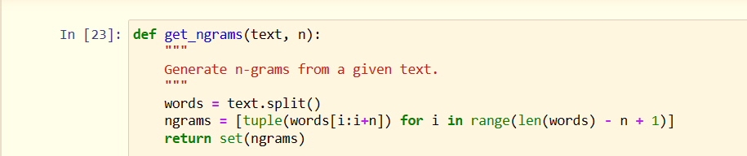
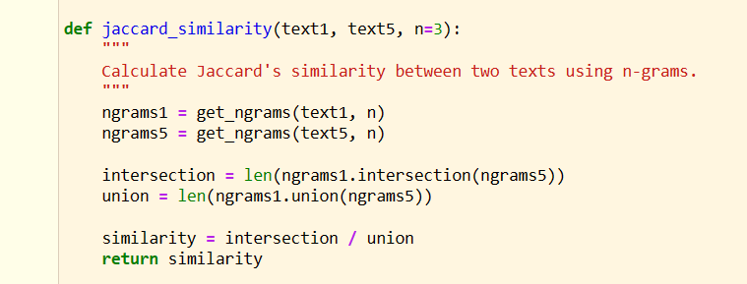
Code
Function to get n-gram of the given input file:
Function to calculate Jaccard similarity of the :

Slide 9
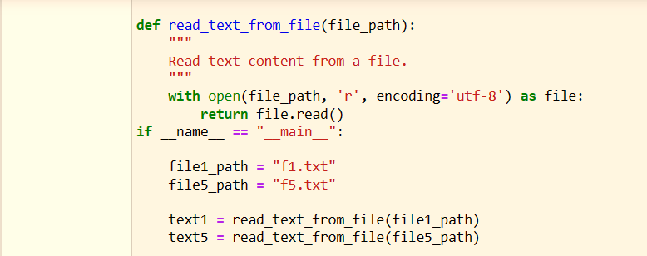
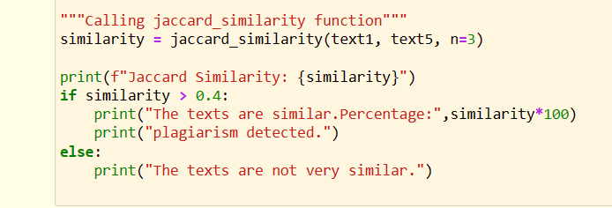
Code
Function to read the text from the input file:
Calling the Jaccard similarity function:

Slide 10
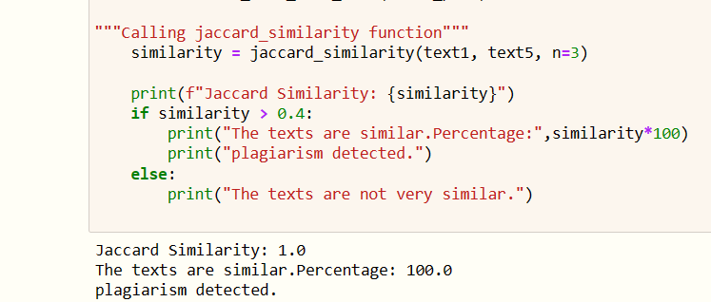
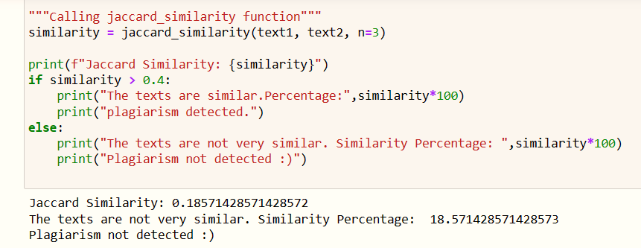
Output:
Input: file 1 and file 5
Threshold value: 0.4
Output: 100.0 plagiarised (fig i)
Note: both file 1 and file 5 contain the same
Kind of information
Input: file 1 and file 2
Threshold value: 0.4
Output: 18.57. Not plagiarised (fig ii)
Note: Some part of file 1 is present in file 2.
fig i.
fig ii.

Slide 11
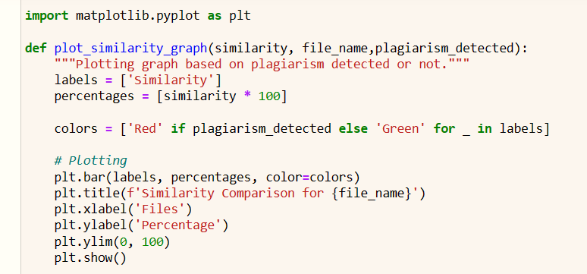
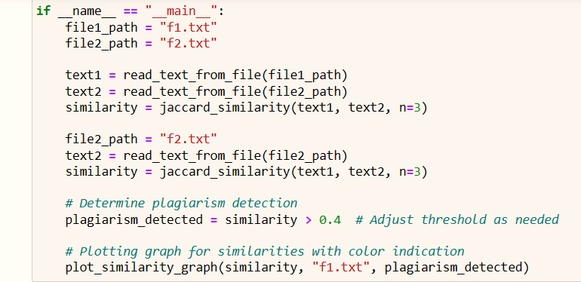
Code to plot the graph:
Defining the graph:
Plotting the plagiarism percentage:

Slide 12
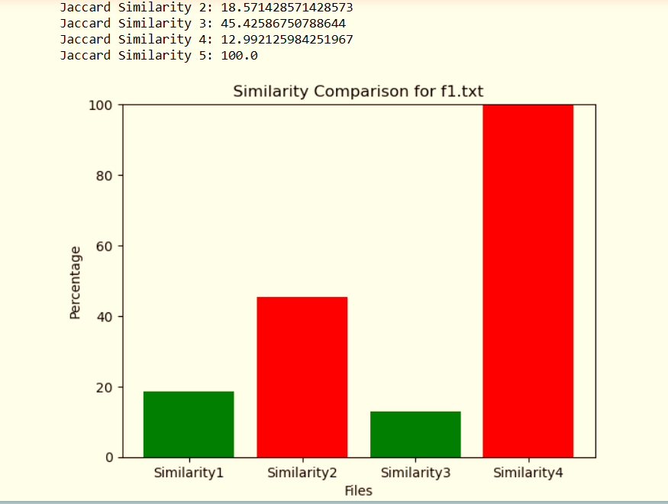
Similarity Chart
1. Input: file 1 and file 2
Threshold value: 0.4
Similarity1 (o/p): 18.57 - Not plagiarised
2. Input: file 1 and file 3
Threshold value: 0.4
Similarity2 (o/p): 45.42 - plagiarised
3. Input: file 1 and file 4
Threshold value: 0.4
Similarity3 (o/p): 12.99 – Not plagiarised
4. Input: file 1 and file 5
Threshold value: 0.4
Similarity4 (o/p): 100.0 plagiarised
NOTE:
file 1 – Original document
file 2,3,4,5 – suspicious document
Threshold value: 0.4
fig iii.

Slide 13
Applications:
Maintains Academic Integrity: Ensures that students and researchers adhere to ethical standards by submitting original work and avoiding plagiarism.
Time Efficiency: Saves time for educators and researchers by automating the process of checking for plagiarism, allowing them to focus on other aspects of their work.
Early Detection of errors: Identifies potential instances of plagiarism early in the writing process, allowing authors to make corrections before submitting their work.
Promotes Originality and Ensures Quality: Encourages writers to produce original and unique content by discouraging the use of unauthorized material.
Ensures the quality and authenticity of academic and professional content by verifying its originality.
Protects Intellectual Property: Safeguards the intellectual property rights of content creators by preventing unauthorized use of their work.

Slide 14
Conclusion:
In the end, we can see how Jaccard Similarity formula is a valuable tool for comparing texts and detecting potential plagiarism.
Its simplicity, flexibility, and accuracy make it a useful asset for users concerned with maintaining the integrity of textual content.
We also saw, how n-gram, are utilized to measure the similarity between two texts. By comparing the sets of n-grams in two texts, one can quantify how similar they are, facilitating plagiarism detection..
In conclusion, the Jaccard Similarity-based Plagiarism Detection project has successfully delivered a valuable tool for comparing texts and detecting potential plagiarism. Its simplicity, flexibility, and accuracy make it a useful asset for users concerned with maintaining the integrity of textual content.

Slide 15
THANK YOU
Notes:
NOTE:
To change the image on this slide, select the picture and delete it. Then click the Pictures icon in the placeholder to insert your own image.

